Slide 1
CS523 - Big Data Technology Prof. Mrudula Mukadam
Final Project
Binh TRAN 986648
ThAO DAO 986646

Slide 2

Problem: Do you know how people talk about what you are thinking on twitter?
Your thoughts maybe about Bitcoin, Trump, upcoming Christmas or TM.
How many people talk about them on Twitter per second?
How much “Trump” is mentioned compare to “Bitcoin” on Twitter every minute?

Slide 3

Problem: Do you know how people talk about what you are thinking on twitter?

Slide 4
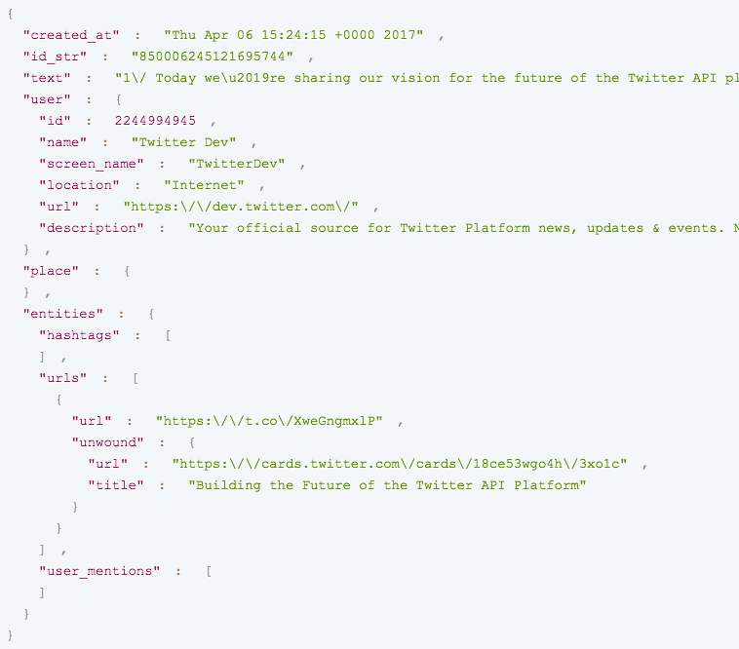
A Tweet in json format

Slide 5

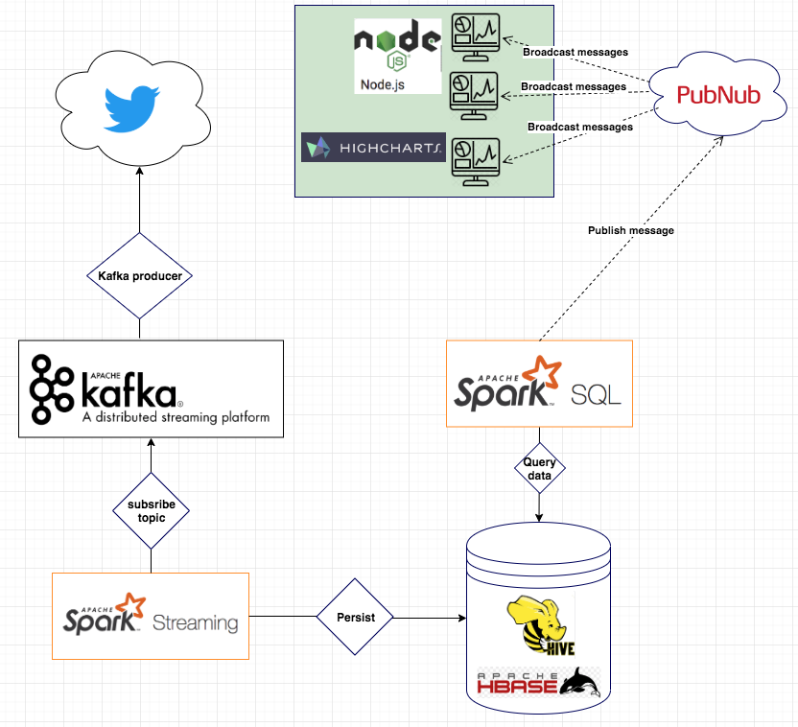
Architecture
Notes:
Seven main components
Apache Kafka:
• Feeds of messages in categories called topics.
• Producers publish messages to a Kafka topic..
• Consumers subscribe to topics and process the feed of published messages.
• Kafka is run as a cluster comprised of one or more servers each of which is called a broker.
Topics - Partitions
Topics - Replication
Spark Streaming:
Subscribe to Kafka topic, get data from that and analyse those data into helpful data. Then store it into HBase
HBase + Hive
As you know HBase is distributed, scalable NOSQL DB with strongly consistent reads and write & Automatic fail-over.
But Hbase do not support SQL language to query data
So why Hive is used on top of HBASE for sql support
SparkSQL
Support Hive, you can create your hive context and directly execute SQL query into your hive table
PubNub
Build low-latency realtime applications that perform reliably and With data from Hbase, spark sql get data and use Pubnub to broadcast to web client
securely, at global scale
With data from Hbase, spark sql get data and use Pubnub to broadcast to web client
NodeJS + HightChart
Highcharts makes it easy for developers to set up interactive charts in their web pages. Make your data come alive

Slide 6
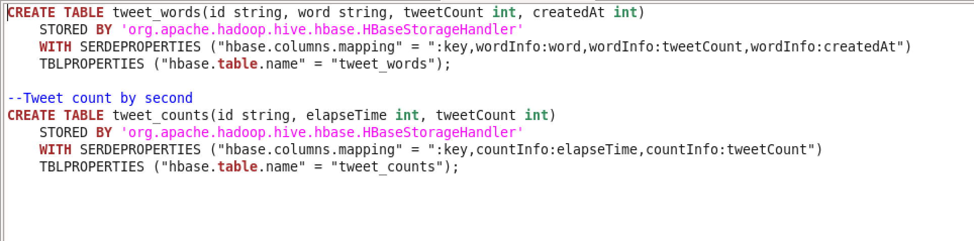
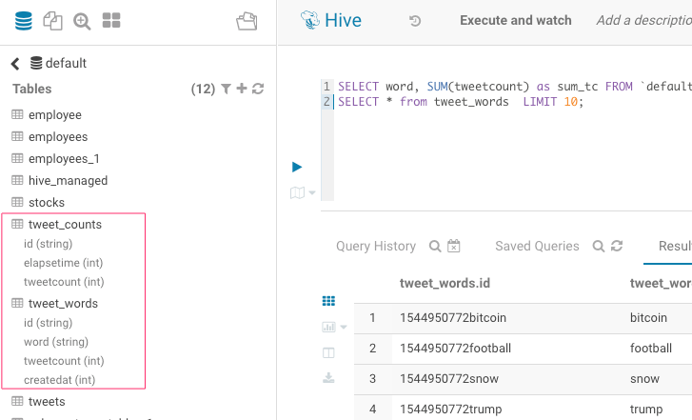
Hive table on TOP of Hbase

Slide 7
Demo + Q&A
Try our live demo at
http://10.10.15.68:3000

